Slide 1


SC 1015 Mini Project
Class: B124 Team 3 Members:
Toh Jia Jun Benjamin(U2221277C)
Yang Jerry(U2220465C)

Slide 2

Dataset & Objectives
Dataset used: Singapore HDB Flat Resale Prices (1990-2020) from Kaggle
Objectives:
Identify key features that affect Resale price
Build a model that predicts resale price
Motivations:
Due to rising prices of housing in Singapore, We wanted to estimate the costs of buying a house in the future. By building a model we can gain more insights into the housing market and predict the price of a house according to its features.

Slide 3

Applications
Roughly gauge the price of a certain resale flat either for buying or selling.
Check if offered price is in reasonable range.

Slide 4

TABLE OF CONTENTS
01
Dataset
02
Methodology
03
Experiments
04
Conclusion
Dataset and Preparation
Models used
Comparison of models
Findings and limitations.

Slide 5
Dataset Components
month | Month and Year of transaction based on approval date
Town | Town of flat
flat_type | Type of flat
block | Block No of flat
Street name | Street Name
storey_range | Storey of flat
floor_area_sqm | Floor area in squared meter
flat_model | Model of flat
lease_commence_date | Date the lease started
Remaining Lease | Number of years before lease expiry
Resale Price | Nominal Resale Price of flat

Slide 6
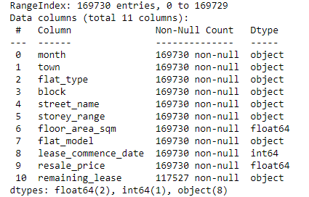
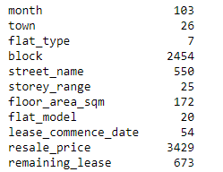
Original Dataset
Number of Unique Values:

Slide 7

01
Dataset Preparation

Slide 8
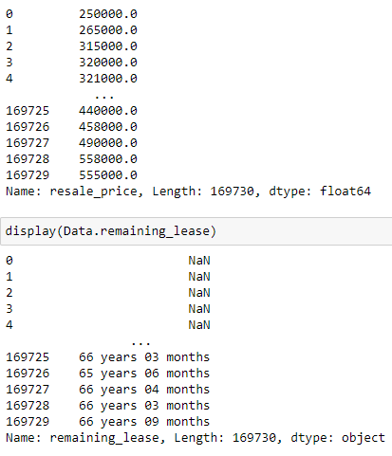
Resale Price
Variable to be predicted

Slide 9
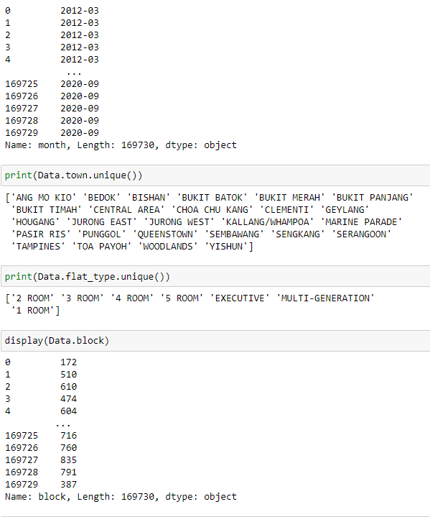
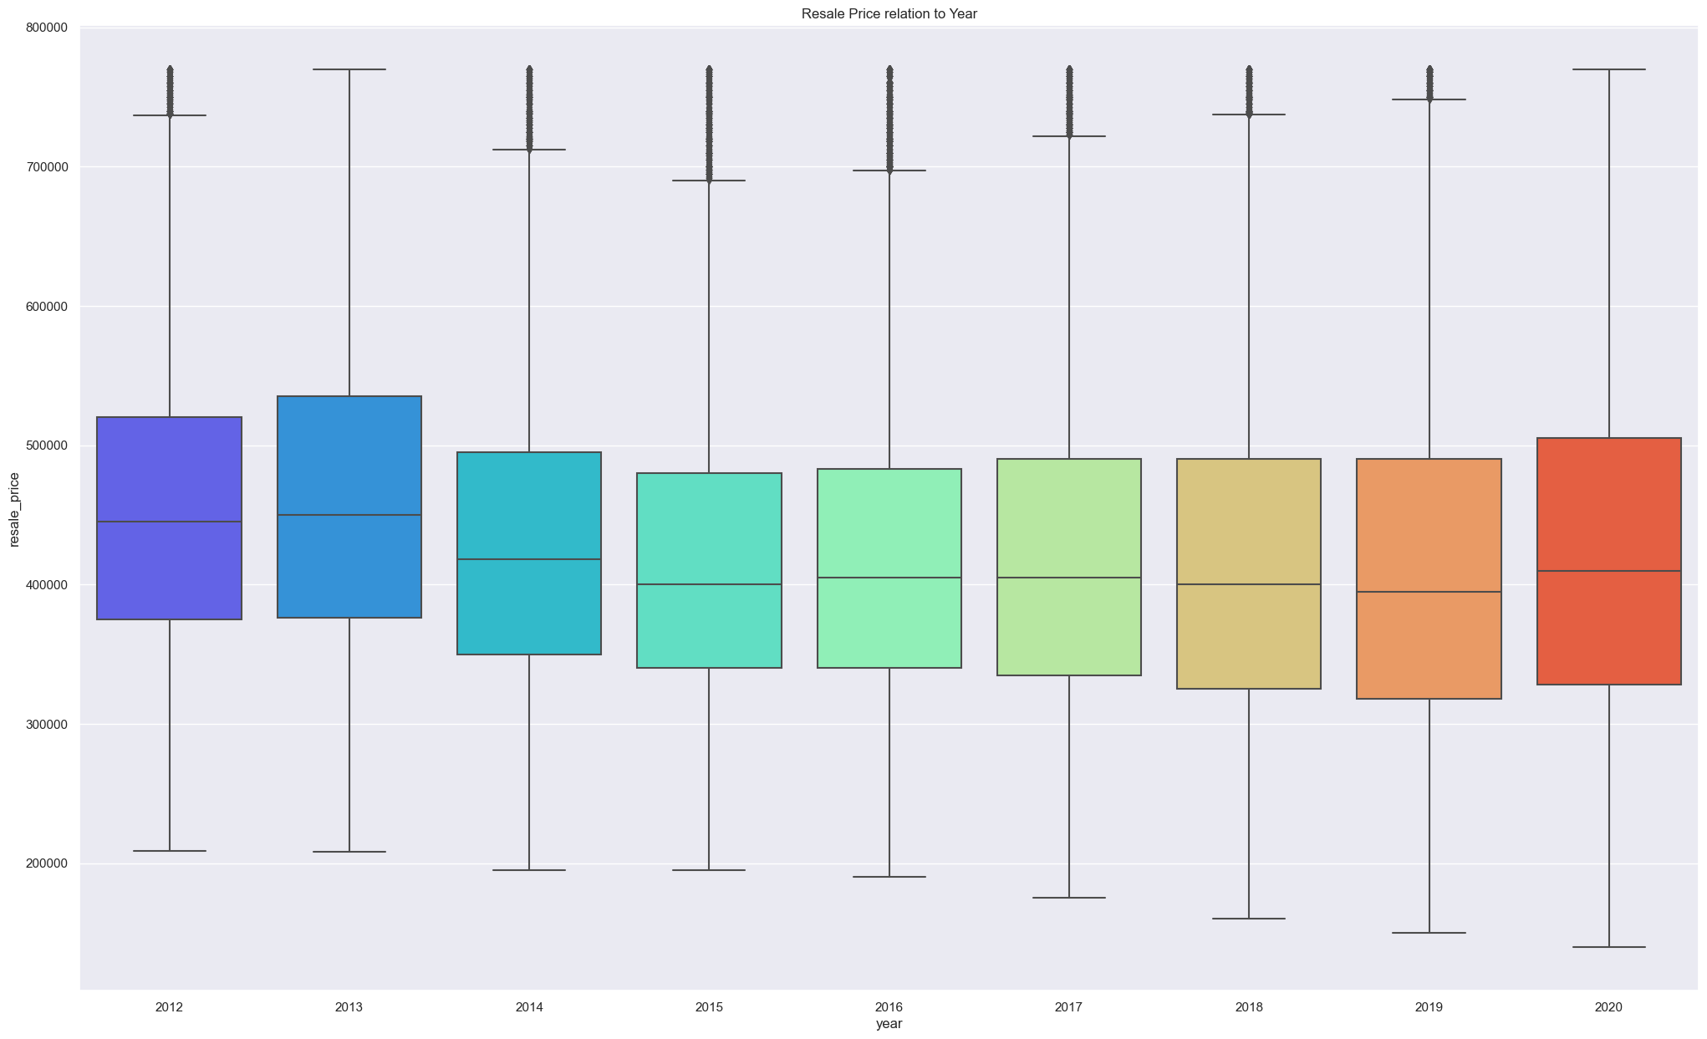
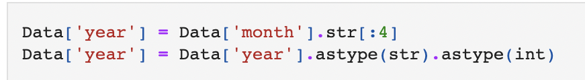
Years
Changed from month to years for simplicity
Shows few fluctuations amongst the years
Talk about convert to Year

Slide 10
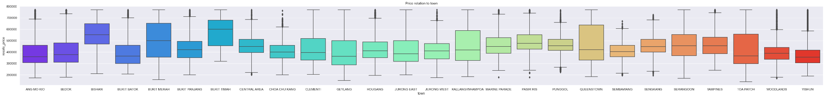
Town
The graph shows that the difference in location has, to some extent, an effect on resale price

Slide 11
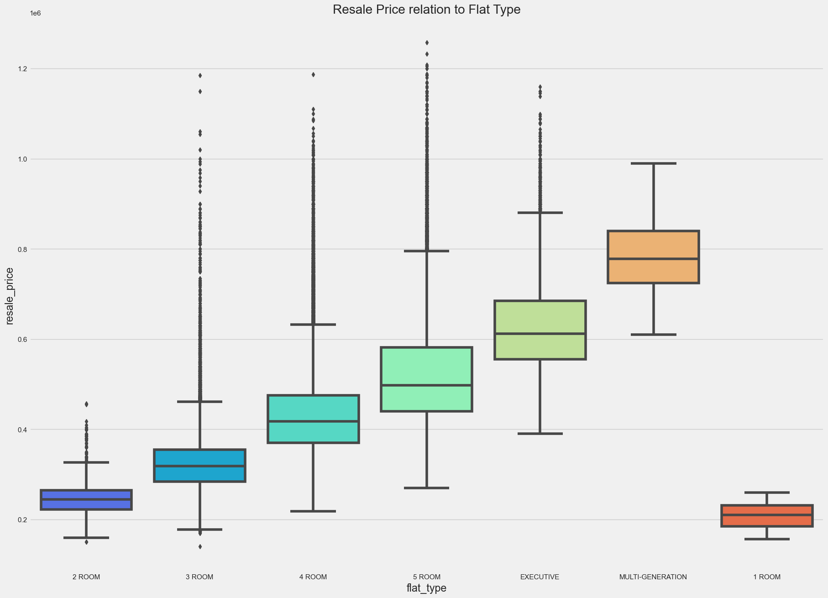
Flat type
6 different flat types and shows positive correlation to resale price

Slide 12
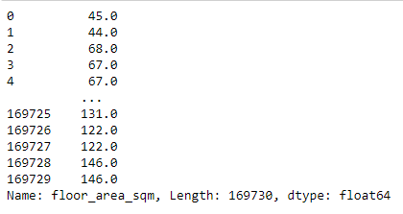
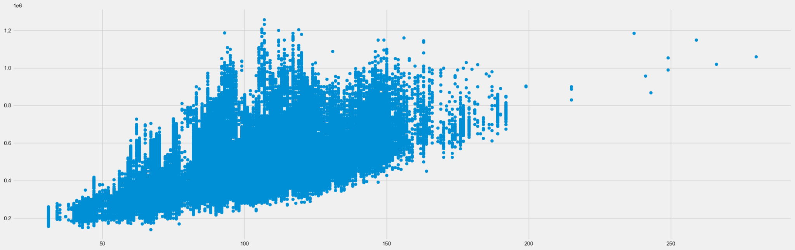
Floor Area in Square Meter
Scatter graph shows positive correlation to resale price although it has some fluctuations in the middle.

Slide 13
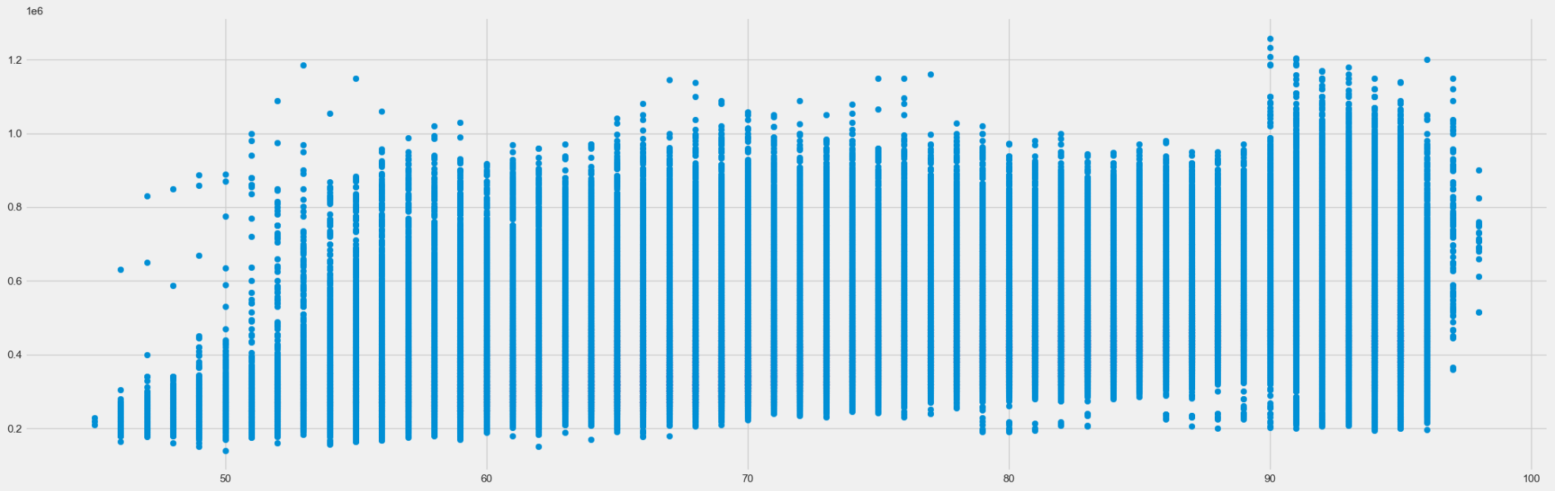
Remaining Lease
Changed to remaining years of lease
Shows some correlation

Slide 14
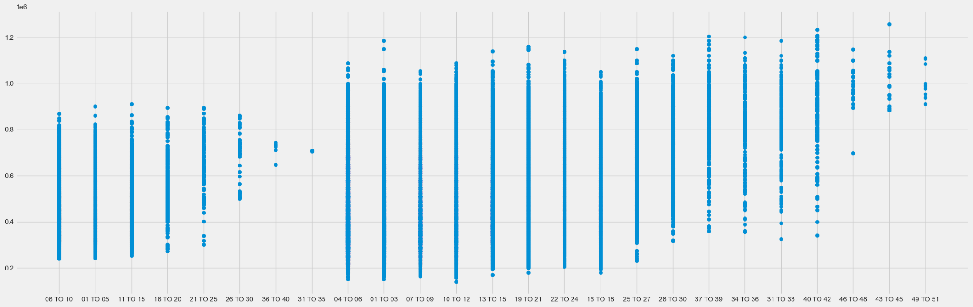
Removed unused Data.
Storey Range
Storey Range has a positive relationship with resale price but only obvious at the higher end.

Slide 15
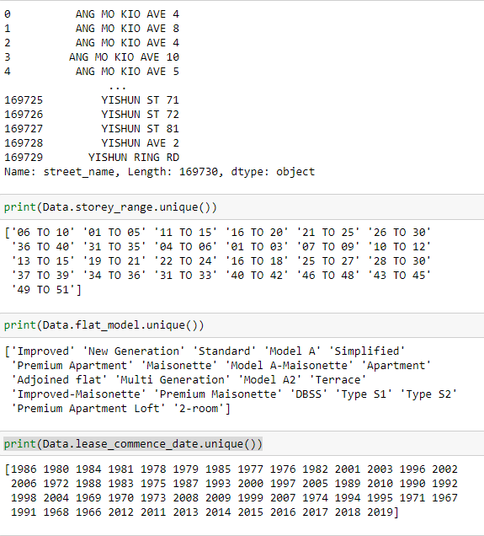
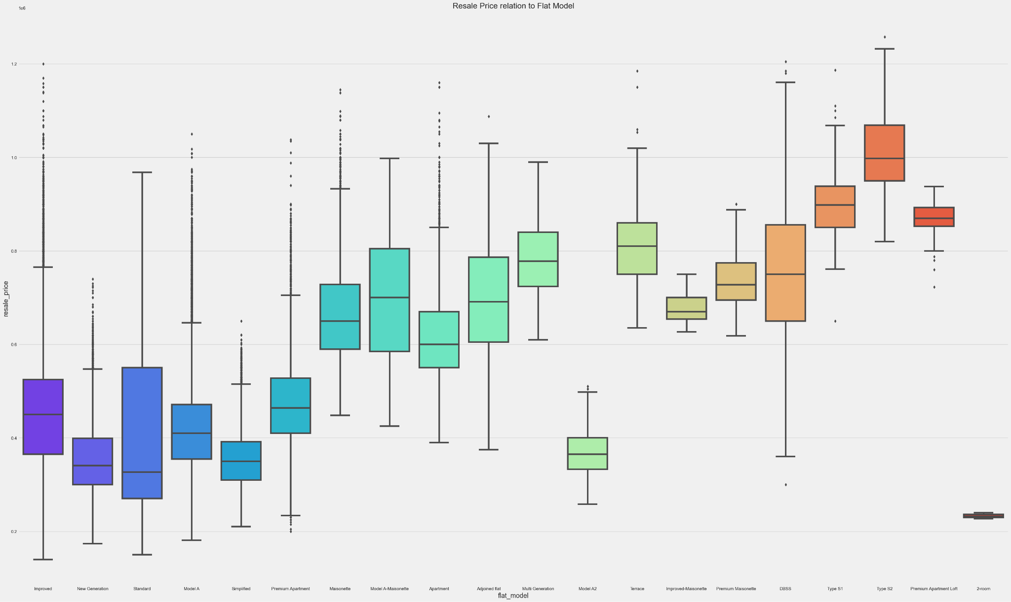
Removed unused Data
Flat Models
The graph indicates that there is a correlation between different flat models and resale price, but the flat models vary by a lot and we do not know the meaning and difference of each of them hence is difficult to encode it to numerical values

Slide 16
Removed unused Data
Street name
This variable shows different street names and is too specific so we decided to use Town instead.

Slide 17
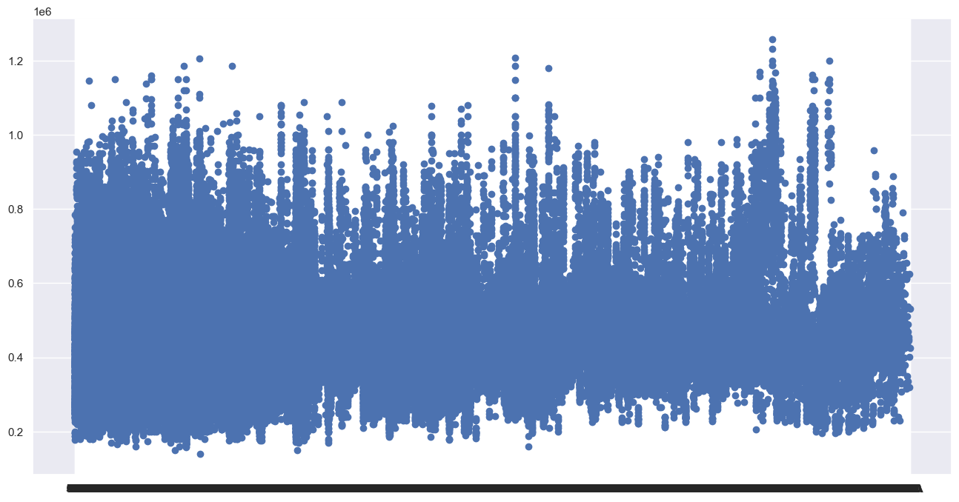
Removed unused data
Block
The Block number does not show any relation with resale Price

Slide 18
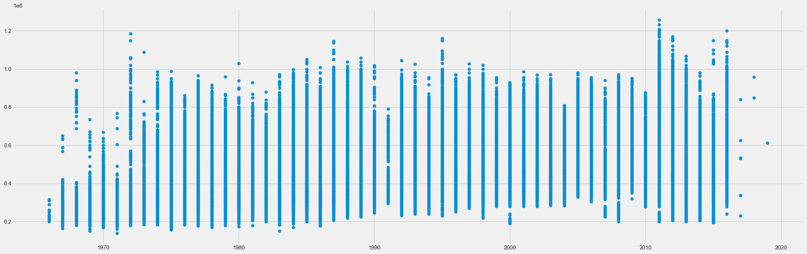
Removed unused data
Lease Commence Date
Similar to remaining lease hence removed

Slide 19
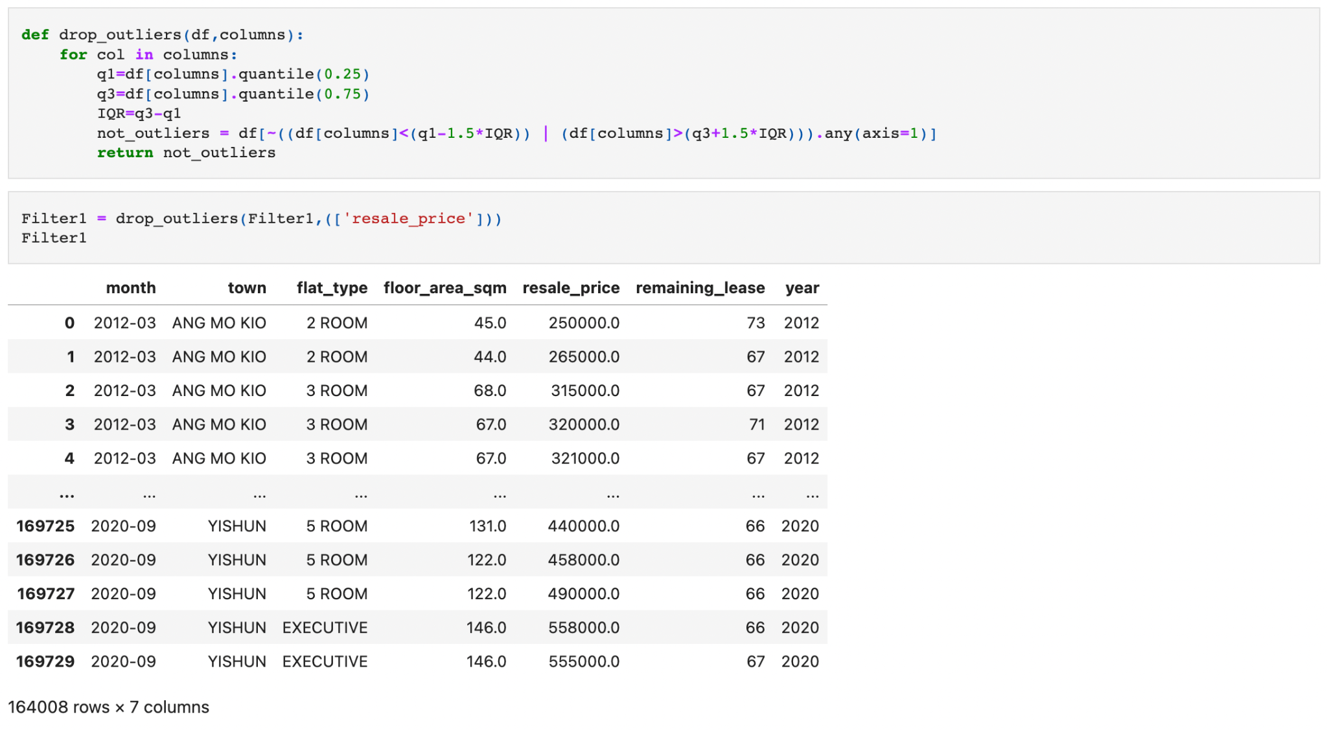
Data preparation
Removed Outliers

Slide 20
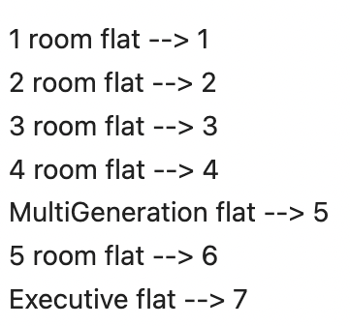
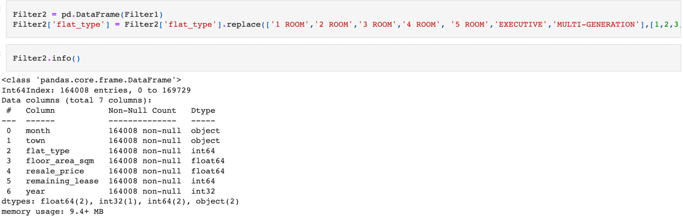
Encoding Categorical Variable
Ordinal encoding
Changing categorical information "flat_type" into numerical with regards to size.

Slide 21
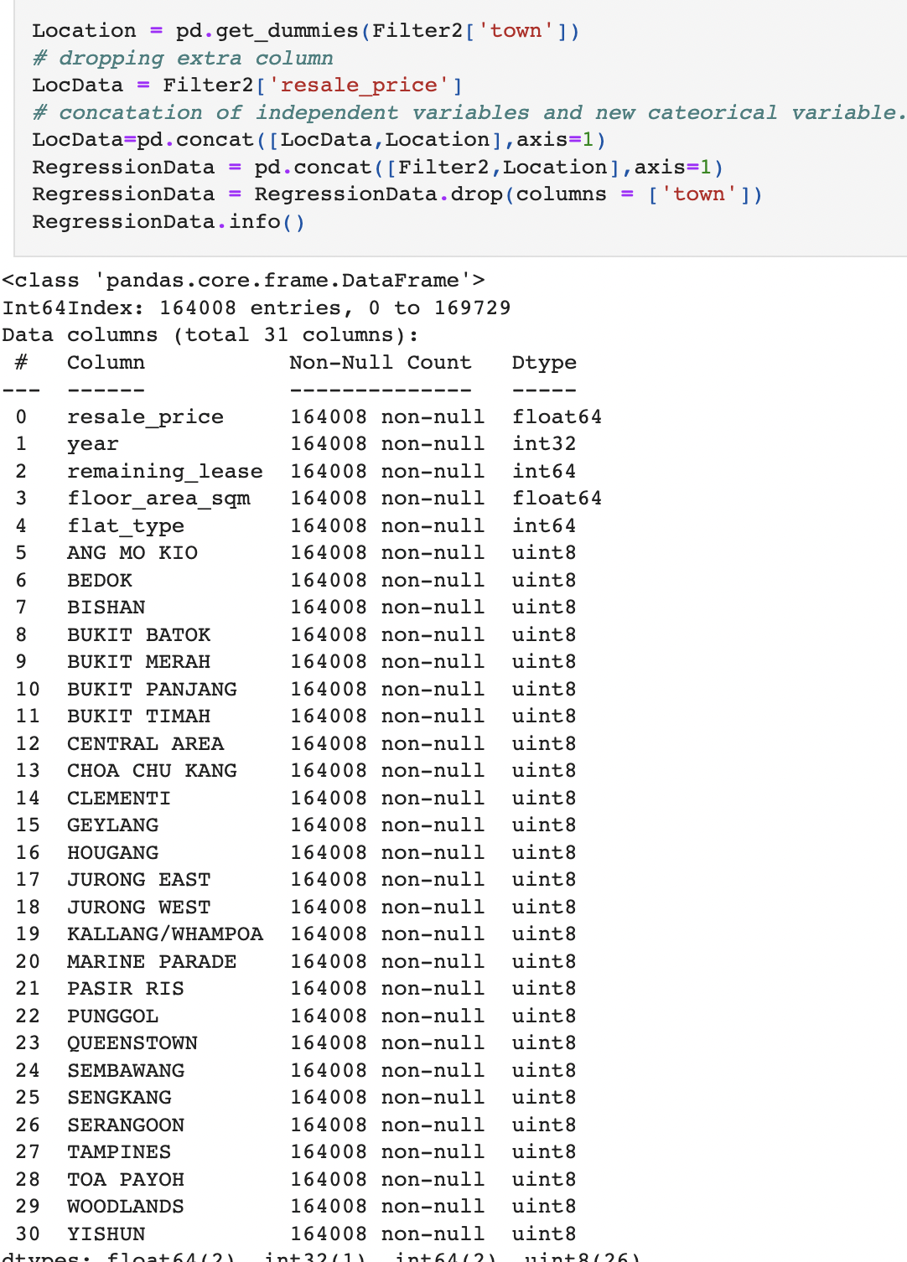
Encoding Categorical Variable
One hot encoding
Using One-hot Encoding to convert Location Data from categorical to Numerical Data

Slide 22
Used Variables
'resale_price'
'year'
'remaining_lease',
'floor_area_sqm',
'flat_type'
'town'

Slide 23
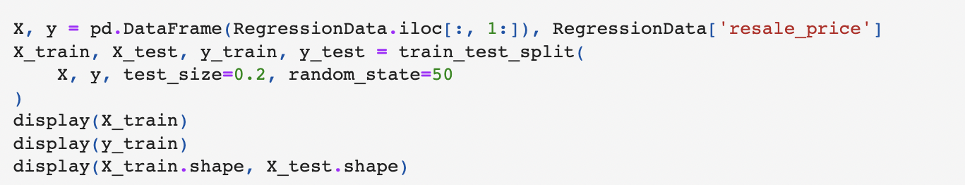
Machine Learning
Selected Models:
Linear Regression
Multiple linear regression
Gradient boosting
Random Forest
Train size : Test size = 80: 20

Slide 24
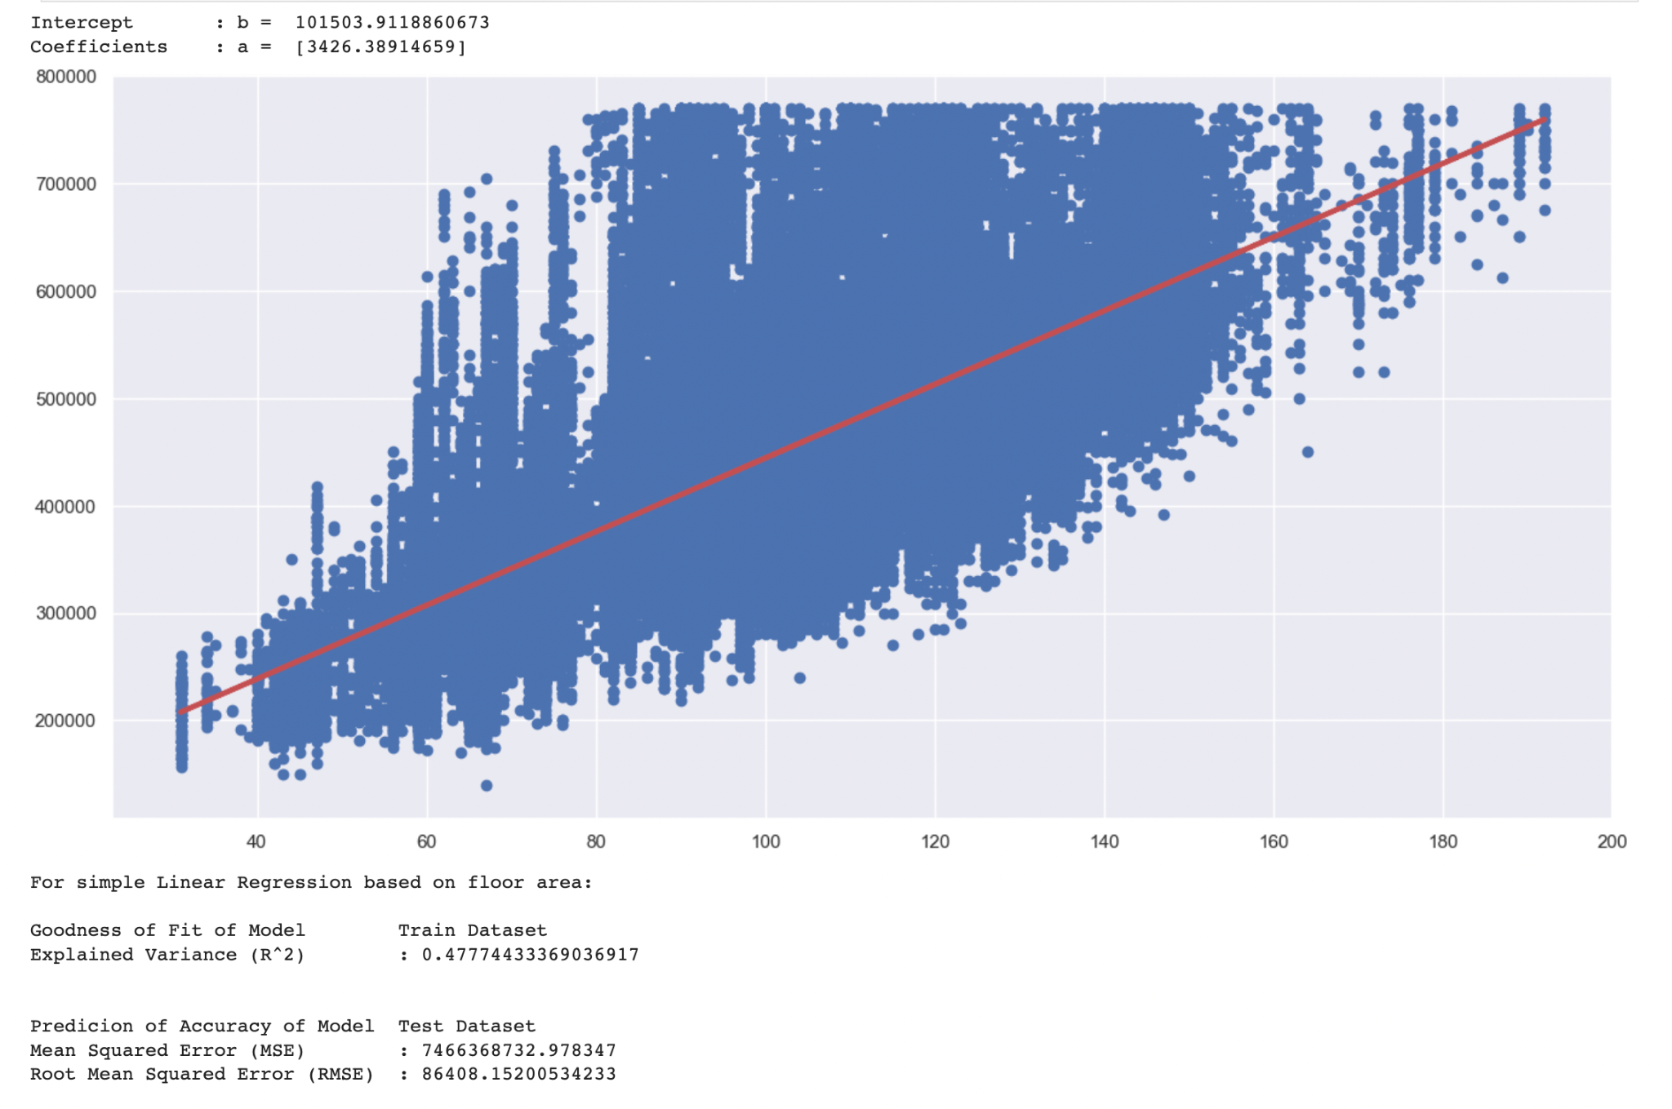
Linear Regression
Basis for comparison
Base standard for comparison with other models
Variables: Floor Area & Resale Price
Evaluation Standards
Explained Variance
Mean Squared Error
Root Mean Squared Error
Absolute Mean Error

Slide 25
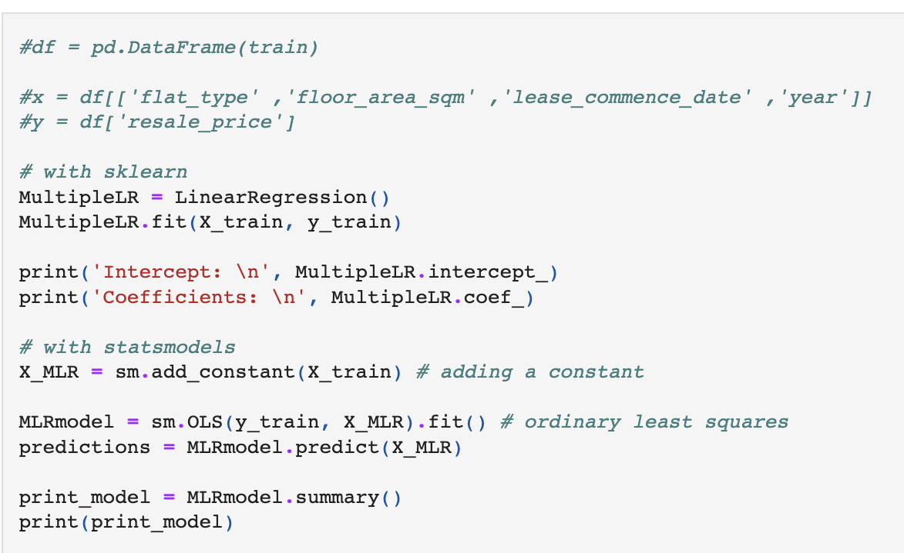
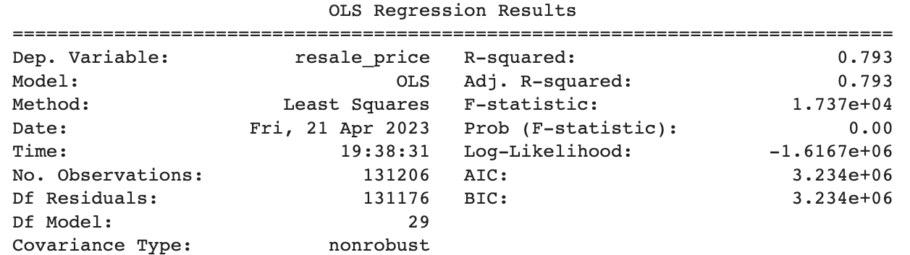
Multiple Linear Regression
Linear Regression with multiple Variables
Multiple linear regression is used to assess the association between two or more independent variables and a single continuous dependent variable.
Variables: 'resale_price', 'Year', 'Remaining_lease', 'Floor_area_sqm', 'Flat_type', 'town'

Slide 26
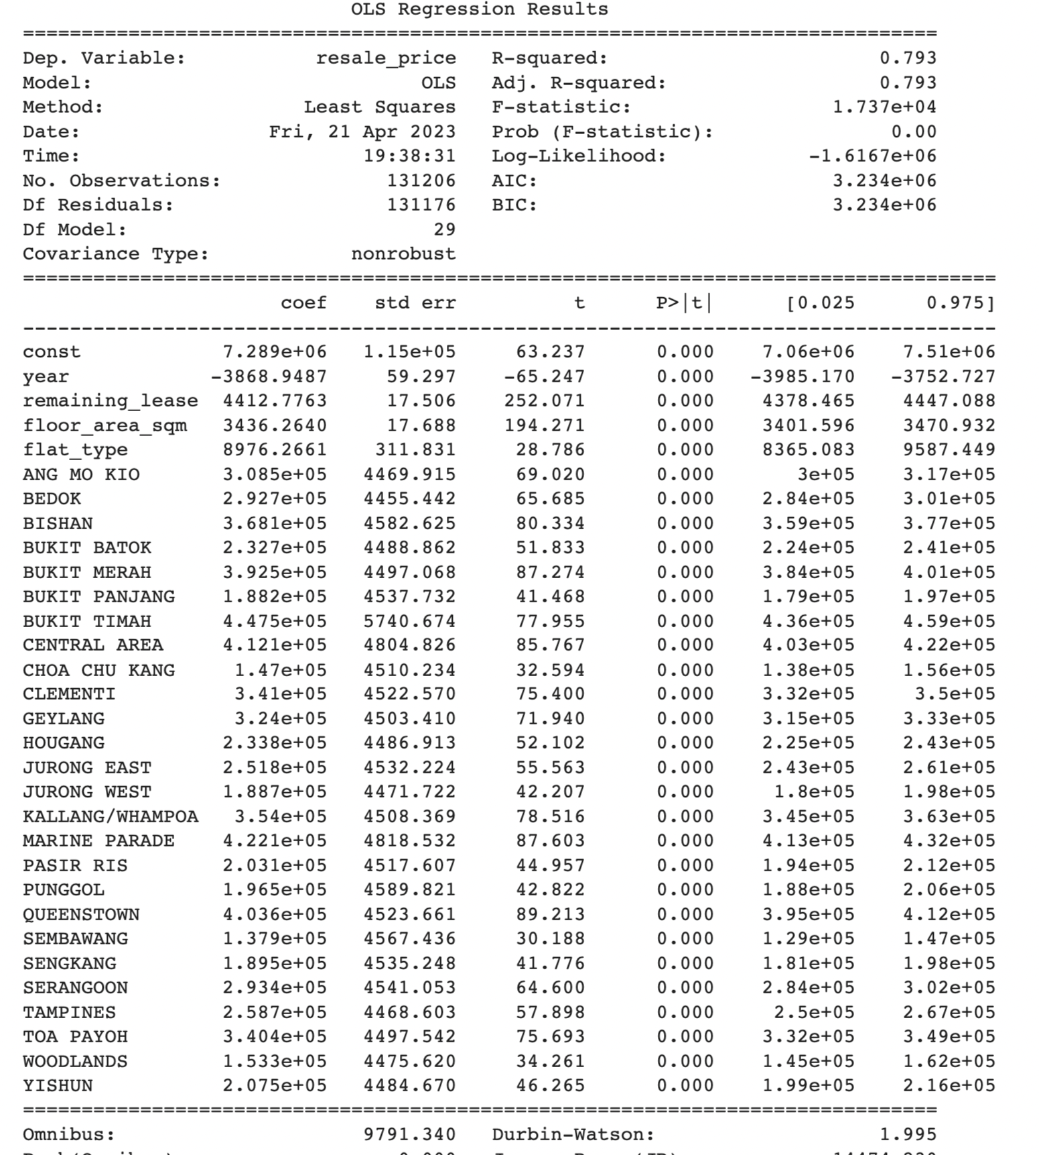
Multiple Linear Regression
R^2 value: 0.79
P values of each independent variables are 0.
Non zero coefficients showing either positive or negative correlations with resale price

Slide 27
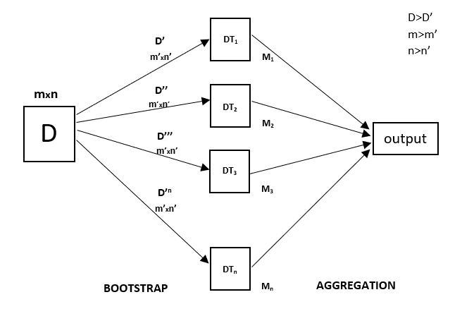
Random Forest
Random forest A supervised Machine Learning Algorithm that builds decision trees on different samples and takes the majority vote for classification and average for regression.
Hyperparameters:
N_estimators
Max depth
Random_state
Notes:
A supervised Machine Learning Algorithm that builds decision trees on different samples and takes the majority vote for classification and average for regression.
Uses the bagging ensemble learning technique(combining multiple models)
-> Creates different training subsets from sample training data with replacement(bootstrap) and final output is based on majority voting/average(aggregation)
->Models are trained independently
-> Gradient Boost uses sequential method.
Important Features of Random Forest <- U decide if you want to add
Diversity: Not all attributes/variables/features are considered while making an individual tree; each tree is different.
Immune to the curse of dimensionality: Since each tree does not consider all the features, the feature space is reduced.
Parallelization: Each tree is created independently out of different data and attributes. This means we can fully use the CPU to build random forests.
Train-Test split: In a random forest, we don’t have to segregate the data for train and test as there will always be 30% of the data which is not seen by the decision tree.
Stability: Stability arises because the result is based on majority voting/ averaging.
Hyperparameters to Increase the Predictive Power (Highlighted = messed with)
n_estimators: Number of trees the algorithm builds before averaging the predictions.
max_features: Maximum number of features random forest considers splitting a node.
mini_sample_leaf: Determines the minimum number of leaves required to split an internal node.
Max depth : int, default=None
The maximum depth of the tree. If None, then nodes are expanded until all leaves are pure or until all leaves contain less than min_samples_split samples.
criterion: How to split the node in each tree? (Entropy/Gini impurity/Log Loss)
max_leaf_nodes: Maximum leaf nodes in each tree
Hyperparameters to Increase the Speed
n_jobs: it tells the engine how many processors it is allowed to use. If the value is 1, it can use only one processor, but if the value is -1, there is no limit.
random_state:controls randomness of the sample. The model will always produce the same results if it has a definite value of random state and has been given the same hyperparameters and training data. (Set to 42 across all models for ease of comparison)
oob_score: OOB means out of the bag. It is a random forest cross-validation method. In this, one-third of the sample is not used to train the data; instead used to evaluate its performance. These samples are called out-of-bag samples.
Advantages and Disadvantages of Random Forest Algorithm
Advantages
1. It can be used in classification and regression problems.
2. It solves the problem of overfitting as output is based on majority voting or averaging.
3. It performs well even if the data contains null/missing values.
4. Each decision tree created is independent of the other; thus, it shows the property of parallelization.
5. It is highly stable as the average answers given by a large number of trees are taken.
6. It maintains diversity as all the attributes are not considered while making each decision tree though it is not true in all cases.
7. It is immune to the curse of dimensionality. Since each tree does not consider all the attributes, feature space is reduced.
8. We don’t have to segregate data into train and test as there will always be 30% of the data, which is not seen by the decision tree made out of bootstrap.
Disadvantages
1. Random forest is highly complex compared to decision trees, where decisions can be made by following the path of the tree.
2. Training time is more than other models due to its complexity. Whenever it has to make a prediction, each decision tree has to generate output for the given input data.
Conclusion
Random forest is a great choice if anyone wants to build the model fast and efficiently, as one of the best things about the random forest is it can handle missing values. It is one of the best techniques with high performance, widely used in various industries for its efficiency. It can handle binary, continuous, and categorical data. Overall, random forest is a fast, simple, flexible, and robust model with some limitations.
https://www.analyticsvidhya.com/blog/2021/06/understanding-random-forest/#:~:text=A.%20Random%20Forest%20is%20a,model%20is%20a%20decision%20tree.

Slide 28
Random Forest
 | 10 estimators and max depth 3 | 500 estimators | 1000 estimators | 1000 estimators and max depth 10
r^2 value | 0.822389 | 0.92396 | 0.92393 | 0.78153
accuracy | Nil | 94.45% | 94.45% | 94.45%
The root mean squared error (RMSE) | 80830 | 33200 | 33210 | 56280

Slide 29
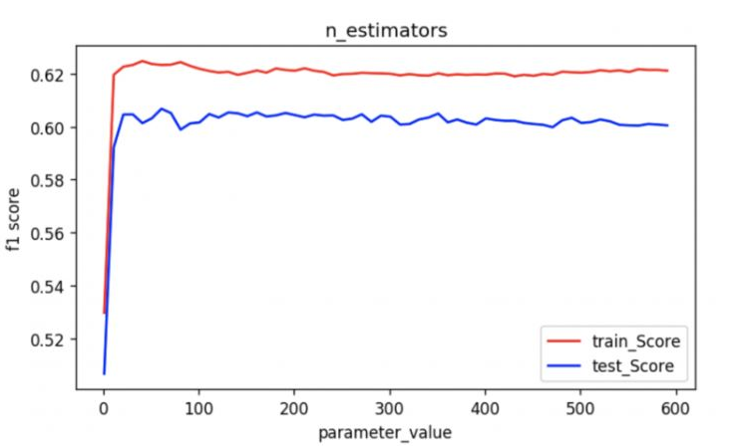
Random Forest
This graph explains why increasing the number of estimators from 500 to 1000 led to a slight decrease in r^2 value.
It shows that the performance of the model increases sharply and stagnates at a certain level, thus choosing a large number of estimators may not always be ideal.

Slide 30
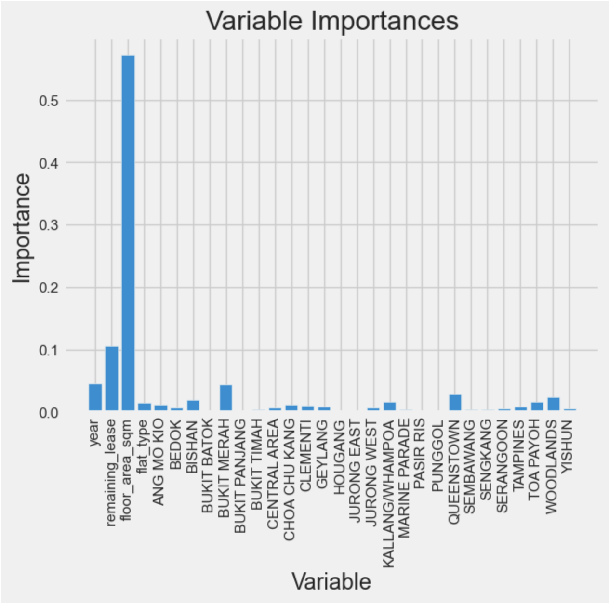
Random Forest
Variable importance
From this we can see the top 2 variables affecting resale price are:
Floor Area
Reaming Lease

Slide 31
Gradient Boosting
Gradient Boosting Regression is a machine learning algorithm used for predicting continuous numerical values. It works by iteratively training weak regression models, such as decision trees, and combining them to form a strong predictor that accurately predicts the target values.
Hyperparameters:
Number of Estimators
Max depth

Slide 32
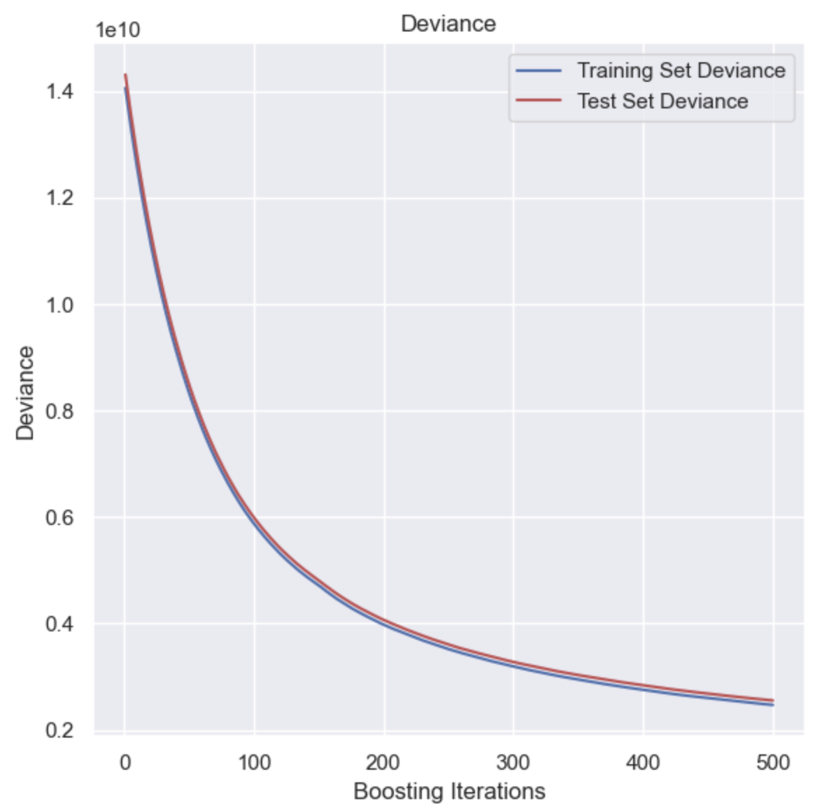
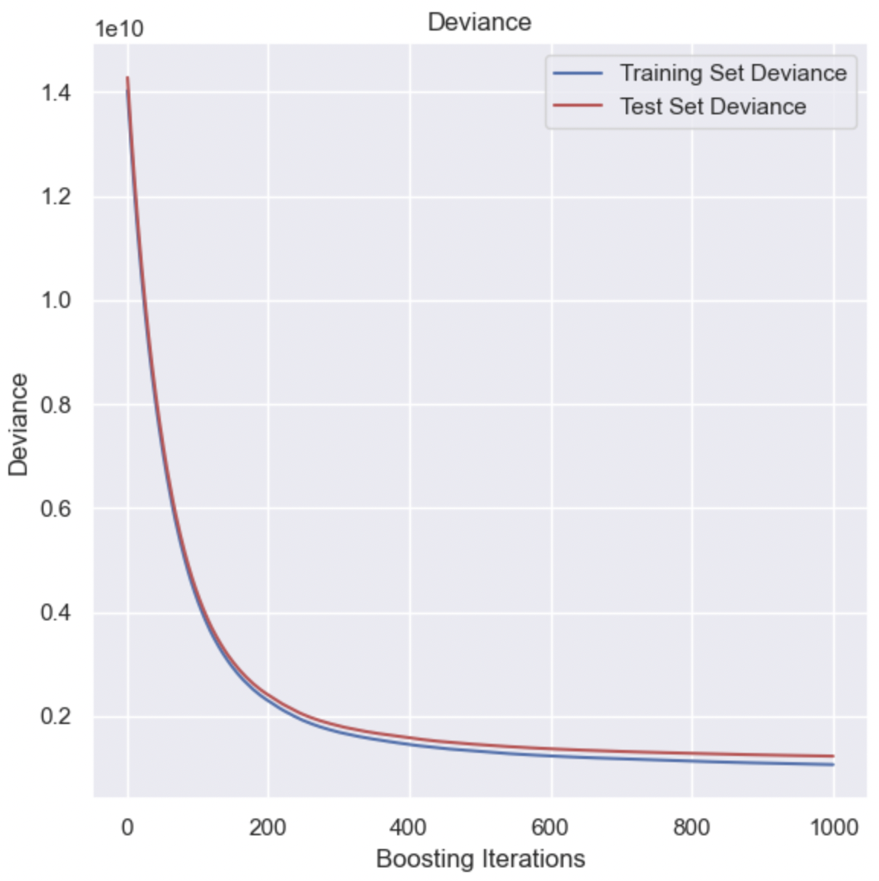
Gradient Boosting
500 estimators & 5 max depth
1000 estimators & 10 max depth

Slide 33
Gradient Boosting
 | 500 estimators & 5 max depth | 1000 estimators & 10 max depth
R^2 | 0.824 | 0.915
MSE | 2550000000 | 1230000000
RMSE | 50500 | 35000

Slide 34
Results
Best Model: Gradient Boosting
Variable of most Importance:
Reasons: Better than Linear and Multiple Linear Regression.
Performs better than Random Forest under same hyperparameters ( N_estimators - number of trees created and Max Depth)
Floor area
Remaining Lease
Other that affects but less significant:
Location, Year, Flat type
Ranking In terms of R2 MSE RMSE and absolute mean error: 1) Gradient Boosting
2) Random Forest (Better without limiting depth)
3) Multiple Linear
4) Linear
Notes:
Honestly this content idk to call it results or conclusion. If you need the images of the numerical results of the error and stuff, you can screenshot from github.
Ultimately chose the Gradient Boosting model as the best for predicting resale price.
MLR and LR is generated in a shorter time but the Error is higher than the Random Forest and Gradient Boosting.
Random Forest and Gradient Boosting takes a longer time but has better R2 and lower error Between Random Forest and Gradient Boosting, Gradient Boosting was chosen as with the same number of estimators and max depth, Gradient Boost has a better accuracy and R2 score and lower errors.

Slide 35
Limitations
Long Runtime
Insufficient data preparation
Runtime can be reduced by finding the optimal number of trees and changing other hyperparameters
Normalisation can help to improve the accuracy of the models
Cross validation with differing random states to increase the validity of the evaluation of the models.
Insufficient Variables
Inflation
Accuracy may be increased with other variables such as distance to MRT or presence of Malls
Inflation across the years can affect the resale price
Notes:
Limitations
More data preparation such as normalisation can be done to help improve the accuracy of the model
Runtime and accuracy may be reduced through changing some of the hyperparameters.
More variables can be added to improve accuracy: such as distance to MRT stations, presence of amenities such as malls nearby
Currency Inflation could be accounted for. Inflation across the years could cause the price of the flats to increase.

Slide 36

THANKS!
Do you have any questions?
youremail@freepik.com
+34 654 321 432
yourwebsite.com
Please keep this slide for attribution

